Slide 1
UML DIAGRAM PRESENTATION (GROUP 3)
MEMBERS:
EMMANUEL KORANTENG.
ISAAC MOUKASA.
MARUF.

Slide 2
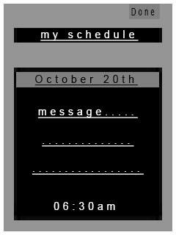
INTERFACE

Slide 3
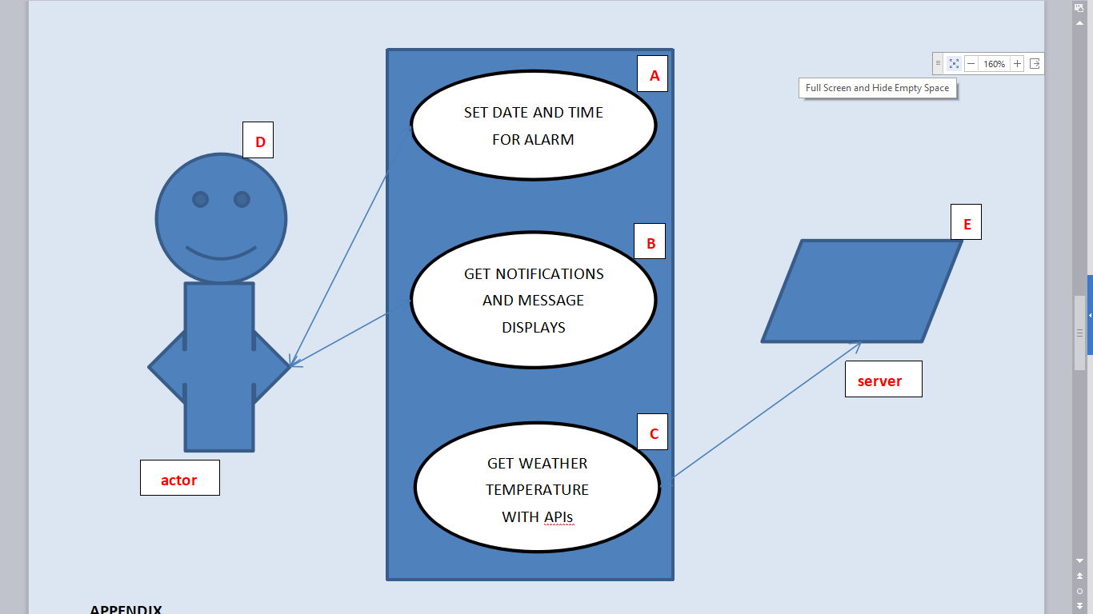
USE-CASE

Slide 4
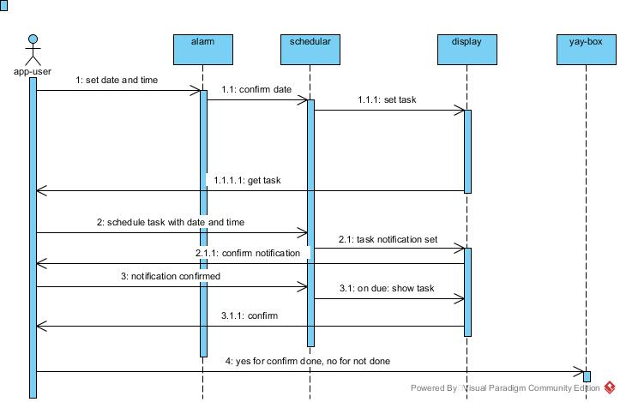

Slide 5
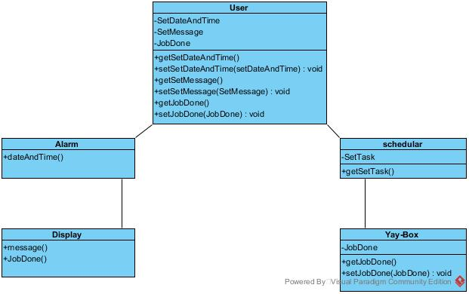
CLASS DIAGRAMS

